Slide 1
Chapter 1
Software Engineering and Project Management
(7 Hrs)
Presented by
Er.Harendra Bikram Shah
Lecturer
Department of Computer Engineering
NAST

Slide 2
OUTLINES
1.1 Nature and Characteristics of Software
1.2 Software Engineering versus System Engineering
1.3 Software Crisis and Myths
1.4 Four Ps of Software Project Management
1.5 Process and Project Metrics
1.6 Measurement of Software: Metrics, Measure, Indicator
1.7 Project Estimation, Empirical Estimation Models
1.8 Software Risks, Assumption, Issues, Dependency
1.8.1 Identification
1.8.2 Mitigation
1.8.3 Monitoring
1.8.4 Management
1.9 Software Engineering Ethics and Professional Practice

Slide 3
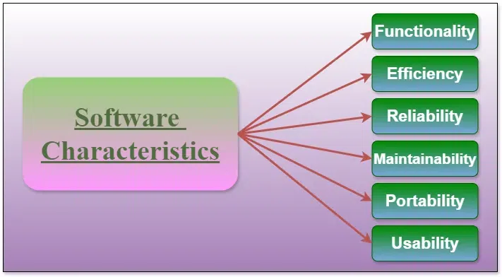
Nature and Characteristics of Software
Collection of computer programs, procedures, rules, and data is software.
Process of designing, developing, testing, and maintaining software is software Engineering.
Components of Software Characteristics

Slide 4
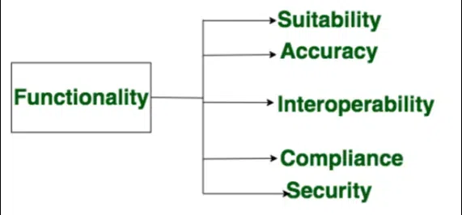
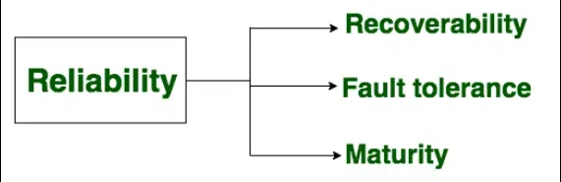
Components of Software Characteristics

Slide 5
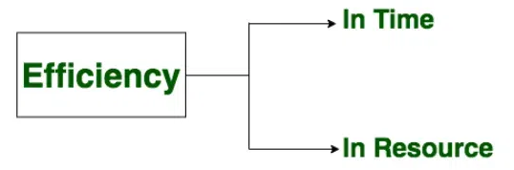
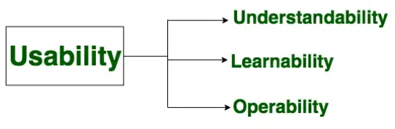
Components of Software Characteristics

Slide 6
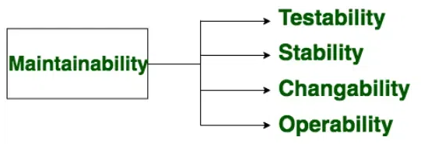
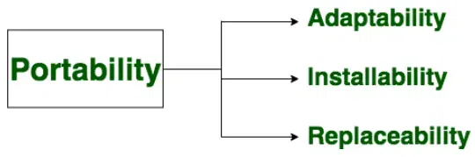
Components of Software Characteristics

Slide 7
Software Engineering versus System Engineering
Aspect | Software Engineering | System Engineering
Focus | Primarily focuses on software development and processes. | Focuses on designing and managing complex systems.
Scope | Narrower scope | Broader scope
Objectives | Develops software applications or systems to meet specific requirements. | Integrates multiple components (hardware, software, processes) to achieve system goals.
Emphasis | Emphasizes software design, coding, testing, and maintenance. | Emphasizes system architecture, integration, and optimization.
Lifecycle | Follows SDLC methodologies. | Involves system lifecycle management from conception to retirement.
Disciplines | Incorporates disciplines like requirements engineering, software design, and quality assurance. | Integrates disciplines such as system architecture, system integration, and system testing.
Skills | Requires strong programming skills, knowledge of algorithms, and software design patterns. | Requires systems thinking, problem-solving skills, and understanding of interdisciplinary concepts.
Examples | Examples:application development, web development, and mobile app development. | Examples :aerospace systems, transportation systems, and healthcare systems.

Slide 8
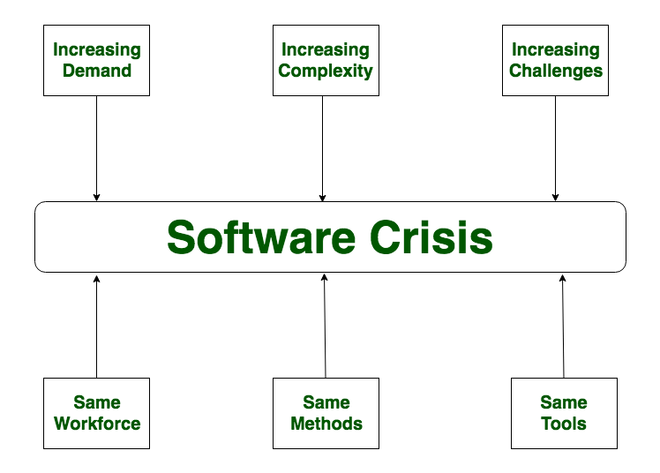
Software Crisis
“software crisis” refers to the numerous challenges and difficulties faced by the software industry during the 1960s and 1970s.
Difficulty of writing useful and efficient computer programs in the required time.

Slide 9
Factors Contributing to Software Crisis
Increasing Complexity:
Lack of Formal Methods:
Changing Requirements:
Limited Reusability:
Poor Quality Assurance:
Lack of Collaboration:
Rapid Technological Changes:
Inadequate Project Management:
Absence of Standards:
Solution of Software Crisis
Structured Methodologies:
Formal Software Development:
Requirements Engineering:
Quality Assurance and Testing:
Code Reusability:
Improved Project Management:
Standardization and Best Practices:

Slide 10
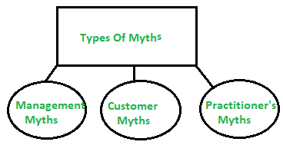
Software Myths
Superstitions (false beliefs or interpretations) or misleading attitudes
(i) Management Myths:
Myth 1:
We have all the standards and procedures available for software development.
Myth 2:
The addition of the latest hardware programs will improve the software development.
Myth 3:
With the addition of more people and program planners to Software development can help meet project deadlines (If lagging behind).

Slide 11
(ii)Customer Myths:
Myth 1:
A general statement of intent is enough to start writing plans and details of objectives can be done over time.
Myth 2:
Software requirements continually change, but change can be easily accommodated because software is flexible
(iii)Practitioner’s Myths:
Myths 1:
They believe that their work has been completed with the writing of the plan.
Myths 2:
There is no other way to achieve system quality, until it is “running”.
Myth 3:
An operating system is the only product that can be successfully exported project.

Slide 12
    DISADVANTAGES OF SOFTWARE MYTHS
Unrealistic Expectations:
Project Delays:
Poor Quality Software:
Scope Creep:
Ineffective Communication:
Wasted Resources:
Customer Dissatisfaction:
Reduced Productivity:
Increased Risk of Project Failure:
Decreased Competitiveness:

Slide 13
    STEPS TO AVOID SOFTWARE MYTHS
Stay Informed:
Continuous Learning:
Data-Driven Decision-Making:
Testing and Validation:
Educate Team Members:
Risk Assessment:

Slide 14
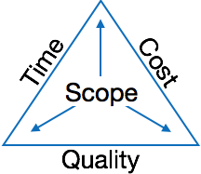
Software Project Management
Software Project Management (SPM) is a proper way of planning and leading software projects.
Need of Software Project Management

Slide 15
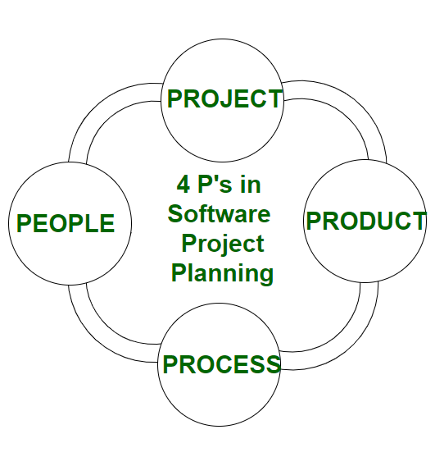
Four Ps of Software Project Management/Planning

Slide 16
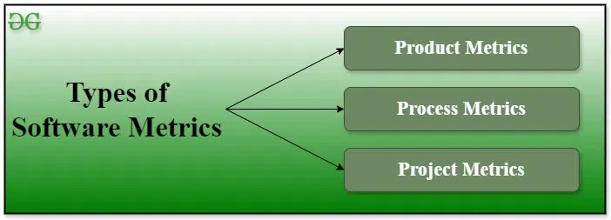
Software Metrics
Quantitative measurements used to assess the efficiency, effectiveness, and quality of software development processes.
4 functions related to software metrics:
Planning
Organizing
Controlling
Improving

Slide 17
Software Metrics
Advantages of Software Metrics
Reduction in cost or budget.
It helps to identify the particular area for improvising.
It helps to increase the product quality.
Managing the workloads and teams.
Reduction in overall time to produce the product,.
Disadvantages of Software Metrics
It is expensive and difficult to implement the metrics in some cases.
Performance of the entire team or an individual from the team can’t be determined.
Sometimes the quality of the product is not met with the expectation.
It leads to measure the unwanted data which is wastage of time.
Measuring the incorrect data leads to make wrong decision making.
Characteristics of software Metrics
Quantitative:
Understandable:
Applicability:
Repeatable:
Economical:
Language Independent:

Slide 18
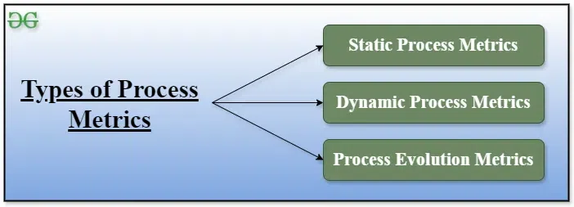
Process Metrics
Process Metrics are the measures of the development process that create a body of software.
length of time that the process of software creation takes.
Static Process Metrics: directly related to the defined process. For example, the number of types of roles, types of artefacts, etc.
Dynamic Process Metrics: related to the properties of process performance. For example, how many activities are performed,
how many artifacts are created, etc.)
Process Evolution Metrics: related to the process of making changes over a period of time. For example, how many iterations
are there within the process)

Slide 19
Top 7 Process Metrics
Lead Time:
measures the time taken from initiating a process to its completion
Cycle Time:
This tracks the duration it takes to complete one full cycle of a process, from beginning to end.
Throughput:
Quantifies the rate at which tasks or features are completed within a given timeframe.
Work in Progress (WIP):
Indicates the number of tasks or features currently being worked on but not yet completed.
Defect Density:
It measures the number of defects or bugs found per unit of work or code.
Process Efficiency:
It evaluates the ratio of value-added work to non-value-added work
Process Compliance:
It ensures consistency and quality in the software development process.

Slide 20
Importance of Process Metrics
Continuous Improvement:
Decision-Making:
Performance Monitoring:
Benchmarking:
Accountability:

Slide 21
Project Metrics
metrics used by the project manager to check the project's progress.
quantitative measures used to track, evaluate, and improve the performance, quality, and progress of a software development project.
Examples :number of software developers, the staffing pattern throughout the software's life cycle, cost, schedule, and productivity.
Benefits of Using Project Metrics
Improved Decision Making:
Enhanced Project Visibility:
Risk Management:
Quality Assurance:
Continuous Improvement:
Types of Project Metrics
1. Productivity Metrics
2. Quality Metrics
3. Schedule Metrics
4. Cost Metrics
5. Customer Satisfaction Metrics
6. Team Performance Metrics

Slide 22
Product Metrics
Product metrics are quantitative measures used to assess the characteristics of software products.
These metrics help in evaluating various aspects such as quality, performance, maintainability, and complexity of the software.
Product metrics fall into two classes:
Dynamic metrics :measurements made from a program in execution.
Static metrics :measurements made from system representations such as design, programs, or documentation.

Slide 23
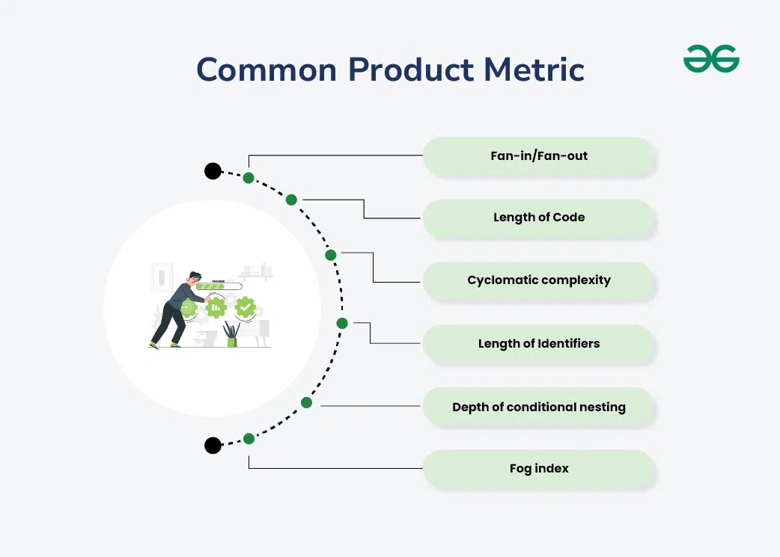
Common Product Metrics
Fan-in is a measure of the number of functions that call some other function (say X).
Fan-out is the number of functions which are called by function X.
measure of the size of a program.
indicate the complexity of a program.
helps in assessing the readability and maintainability of the code.
It indicates how many levels deep the nested conditional statements go.
It is a measure of the average length of words and sentences in documents.

Slide 24
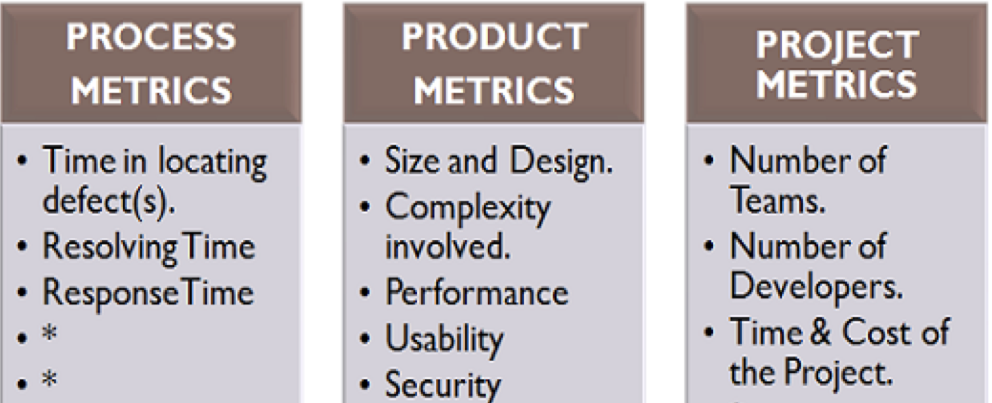
Software Metrics Comparisons

Slide 25
Measurement of Software: Metrics, Measure, Indicator
Software Measurement is process of quantifying various attributes and aspects of a software product or its development process.
The software measurement process is defined and governed by ISO Standard.
Software Measurement Principles/Activities
The software measurement process can be characterized by five activities-
Formulation:
Collection:
Analysis:
Interpretation:
Feedback:

Slide 26
Need for Software Measurement
Software is measured to:
Create the quality of the current product or process.
Anticipate future qualities of the product or process.
Enhance the quality of a product or process.
Regulate the state of the project concerning budget and schedule.
Enable data-driven decision-making in project planning and control.
Identify bottlenecks and areas for improvement to drive process improvement activities.
Ensure that industry standards and regulations are followed.
Give software products and processes a quantitative basis for evaluation.
Enable the ongoing improvement of software development practices.
Classification of Software Measurement
There are 2 types of software measurement:
Direct Measurement: the product, process, or thing is measured directly using a standard scale.
Indirect Measurement: the quantity or quality to be measured is measured using related parameters i.e. by use of reference.

Slide 27
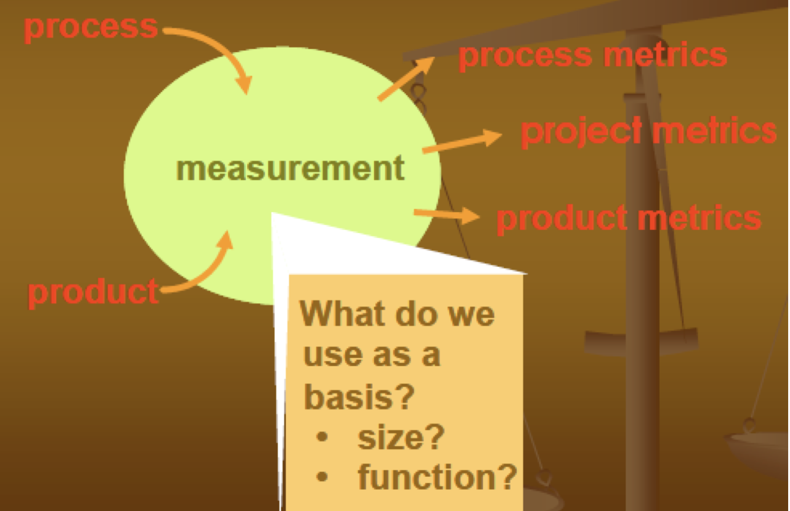
WHAT SHOULD BE MEASURED (LAST CLASS)

Slide 28
Software Measurement Indicators
Essential metrics used to assess various aspects of software development processes, products, and resources.
Types of software measurement indicators
1. Product Metrics
2. Process Metrics
3. Resource Metrics
4. Project Metrics
5. Customer Satisfaction Metrics
6. Security Metrics
Importance of Software Measurement Indicators
Improving Quality
Predicting Project Outcomes
Enhancing Productivity
Risk Management
Customer Satisfaction

Slide 29
Project Estimation, Empirical Estimation Models
Project Size Estimation Techniques are essential tools that help in predicting the required resources, time, and cost.
Project size estimation is determining the scope and resources required for the project.
Importance of Project Size Estimation
Financial Planning
Resource Planning
Timeline Creation
Identifying Risks
Detailed Planning
Planning Quality Assurance
Who Estimates Projects Size?
Project Manager
Subject Matter Experts (SMEs)
Business Analysts
Technical Leads
Developers
Financial Analysts
Risk Managers
Clients

Slide 30
Different Methods/Models of Project Estimation
Expert Judgment: a group of experts in the relevant field estimates the project size based on their experience and expertise
Analogous Estimation: estimating based on the similarities between the current project and previously completed projects.
Bottom-up Estimation: the project is divided into smaller modules or tasks, and each task is estimated separately.
Three-point Estimation: estimating the project size using three values: optimistic, pessimistic, and most likely.
Function Points: estimating the project size based on the functionality provided by the software.
Use Case Points: estimating the project size based on the number of use cases that the software must support.
Parametric Estimation: mathematical models founded on project parameters and historical data are used.
COCOMO (Constructive Cost Model): algorithmic model that estimates effort, time, and cost in software projects
Wideband Delphi: estimating method for balanced size estimations that combines expert estimates from anonymous experts with cooperative conversations.
Monte Carlo Simulation: estimates project size and analyses hazards using statistical methods and random sampling.

Slide 31
Empirical Project Estimation Techniques
Empirical estimation technique are based on the data taken from the previous project and some based on guesses and assumptions.
Empirical estimation is a technique or model in which empirically derived formulas are used for predicting the data that are a required and essential part of the software project planning step.
It uses the size of the software to estimate the effort.
In this technique, an educated guess of project parameters is made.
Hence, these models are based on common sense
Two most common type of Empirical Project Estimation Techniques are:
Expert Judgment Technique
Delphi Cost Estimation Technique

Slide 32
Expert Judgement Techniques
Expert judgment techniques are methods used to gather insights, opinions, and judgments from individuals who have specialized knowledge or expertise relevant to a particular subject or problem.
These techniques leverage the expertise of knowledgeable individuals to enhance decision-making and problem-solving processes.
Here are some common expert judgment techniques:
Interviews:
Workshops:
Expert Panels:
Surveys:
Questionnaires:

Slide 33
Delphi Cost Estimation Technique
The Delphi technique can indeed be applied to cost estimation in project management and other domains where accurate estimation is crucial.
Steps Involved in Delphi Cost Estimation:
Selection of Experts:
Round 1 - Initial Estimates:
Round 2 - Feedback and Discussion:
Round 3 - Revised Estimates:
Final Estimate:

Slide 34
Delphi Cost Estimation Technique
Advantages:
Expertise Utilization:
Anonymity[Reducing Biasness]:
Iterative Process:
Risk Mitigation:
Disadvantages of Delphi Method
1. Interpretation Depends on Responder Expertise:
2. Limited Open Discussion:
3. Requires Commitment for Multiple Rounds:

Slide 35
Software Risk Management
focuses specifically on identifying, assessing, and mitigating risks associated with developing, deploying, and maintaining software systems.
There are mainly 3 classes/ Categories of risks that may affect a computer code project:
Project Risks:
Technical Risks:
Business Risks:
Benefits of risk management
Helps protect against potential losses.
Improves decision-making by considering risks.
Reduces unexpected expenses.
Builds resilience against unexpected challenges.
Limitation of Risk Management
Too much focus on risk can lead to missed opportunities.
Implementing risk management can be expensive.
Risk models can be overly complex and hard to understand.
Managing risks can take a lot of time and resources.

Slide 36
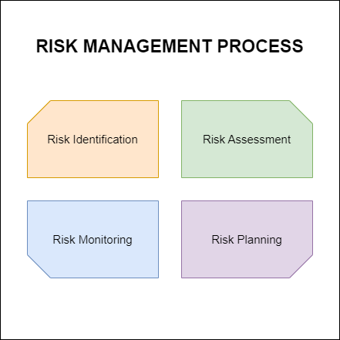
Software Risk Management

Slide 37
Software Issues
1. Functional Issues
2. Performance Issues
3. Compatibility Issues
4. Security Issues
5. Usability and Accessibility Issues
6. Data Handling Issues
7. Development and Maintenance Issues
8. Deployment and Integration Issues
Addressing Software Issues
Regular Testing:
Monitoring and Logging:
User Feedback:
Updates and Patching:
Quality Assurance Practices:

Slide 38
Software Engineering Ethics and Professional Practice
Goal:
Establish a code of conduct for professional software engineers to make software engineering a beneficial and respected profession.
﻿Joint Effort by lEEE-Computer Society and Association of Computing MachineryACM
Software engineers are those who contribute either by direct participation or by
﻿teaching,
﻿analysing,
﻿Specification generating,
﻿designing,
﻿developing,
﻿certifying,
﻿Maintaining and
﻿testing
of software system

Slide 39
Software Engineering Ethics and Professional Practice
Roles of Engineers
"Professional Software Engineers" include
Practitioners
  Educators
Managers
Supervisors
Policy makers
Trainees and Students of the Profession

Slide 40
Software Engineering Ethics and Professional Practice
1. PUBLIC
Software engineers shall act consistently with the public interest
2. CLIENT AND EMPLOYER
Software engineers shall act in a manner that is in the best interests of their client and employer, consistent with the public interest
3.PRODUCT
Software engineers shall ensure that their products and related modifications meet the highest professional standards possible
4. JUDGMENT
﻿Software engineers shall maintain integrity and independence in their professional judgment
5. MANAGEMENT
﻿Software engineering managers and leaders shall subscribe to and promote an ethical approach to the management of software development and maintenance
6. PROFESSION
﻿Software engineers shall advance the integrity and reputation of the profession consistent with the public interest
7. COLLEAGUES
﻿﻿Software engineers shall be fair to and supportive of their colleagues
8. SELF
﻿Software engineers shall participate in lifelong learning regarding the practice of their profession and shall promote an ethical approach to the practice of the profession

Slide 41
Software Engineering Ethics
Professional Practices:
Continuous Learning:
Clear Communication:
Accountability: .
Teamwork:
Adherence to Standards:
Ethical Challenges in Software Engineering:
Privacy and Security:
Bias and Discrimination:
Environmental Impact:
Intellectual Property:
Social Responsibility:

Slide 42
End of The Unit

Slide 43
THANK YOU

